Slide 1
Tech@Agoda – Docker for Dev Zero to Hero (Workshop)
By Joel and Prateek

Slide 2

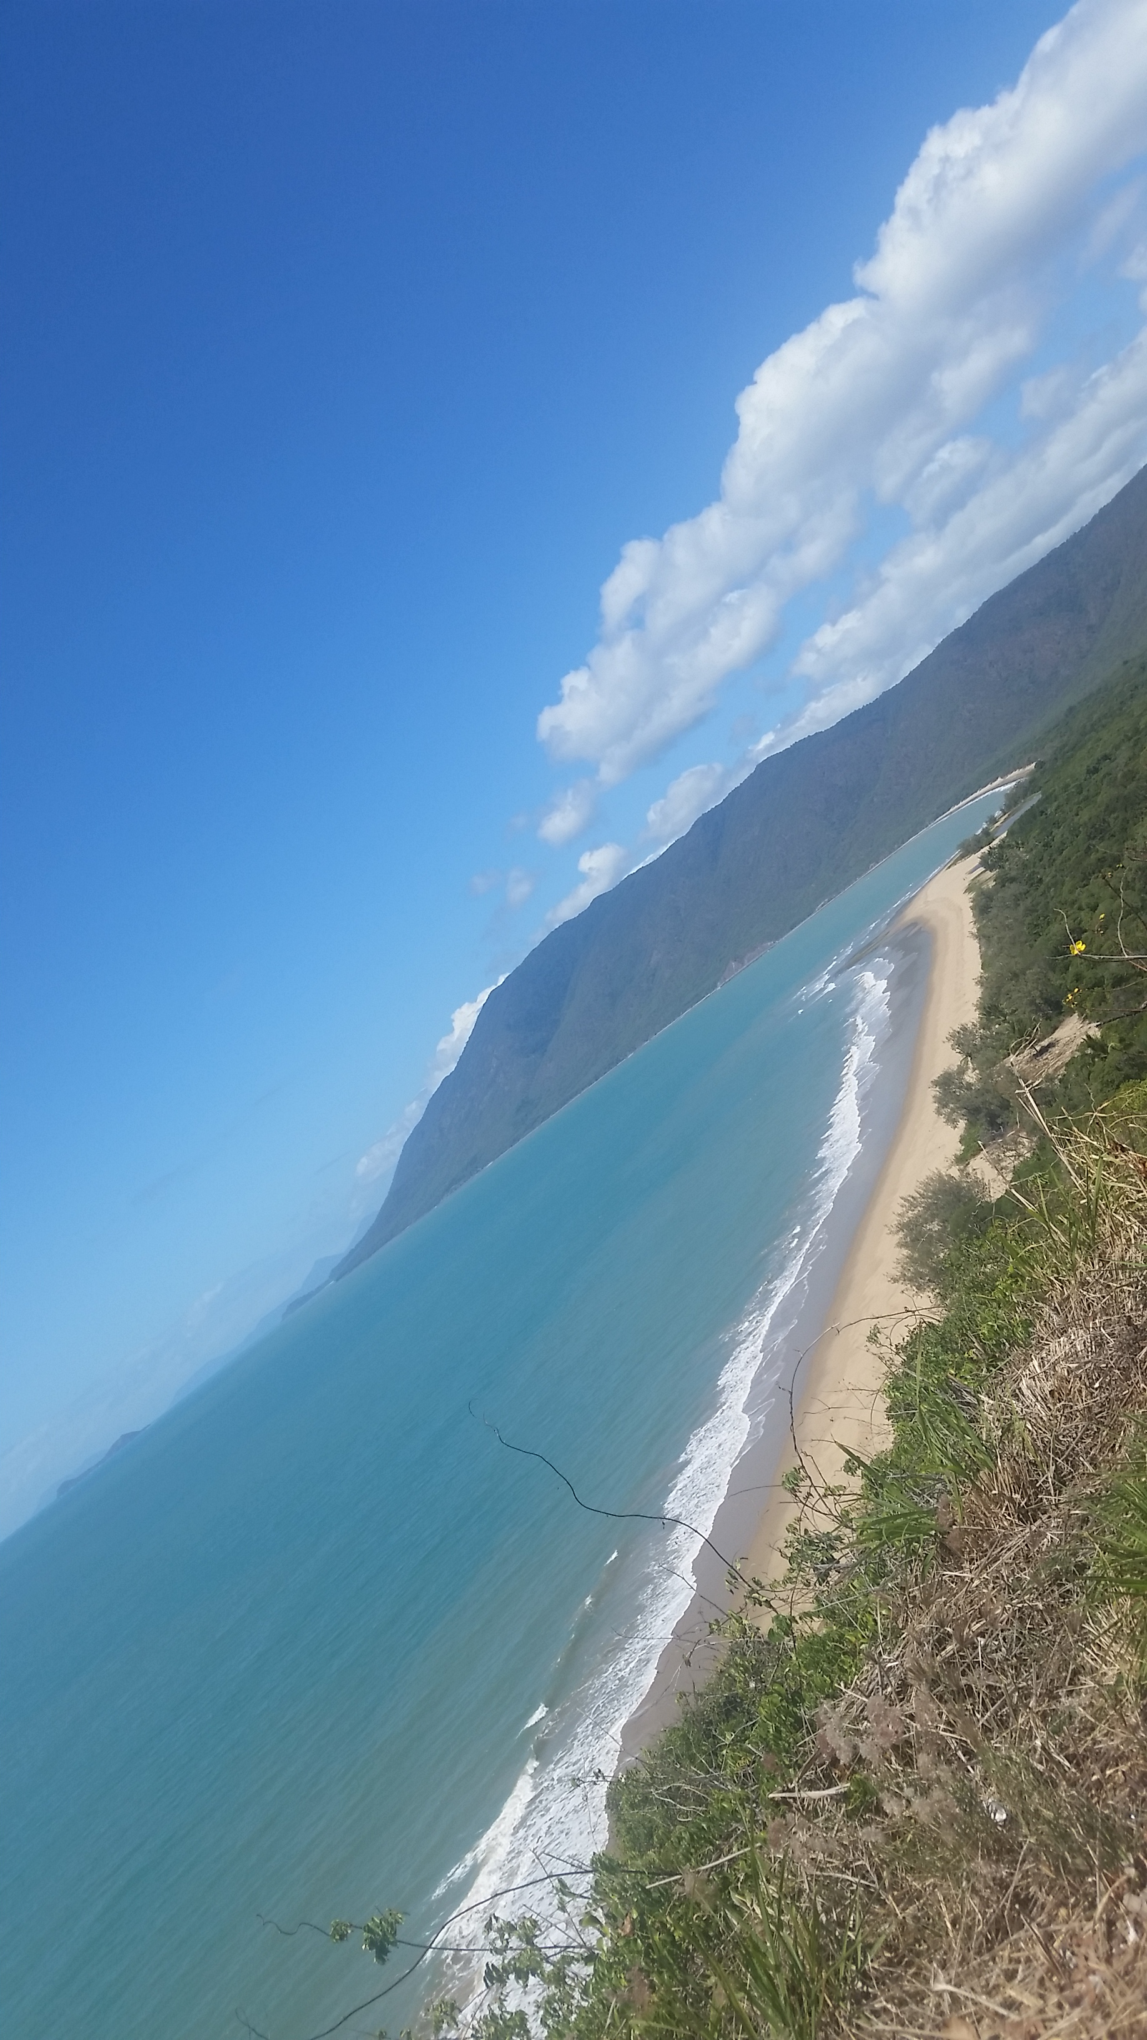
I am Joel Dickson
Development Manager at Agoda
Open Source Contributor (NUnit)
Coming to Thailand for 10 years for business
Working at Agoda for 3 years
I live in Bangkok
I like Beer and Sport
Originally From
Cairns, Queensland, Australia
2,400 km North of Sydney
(26 hour drive in car)

Slide 3
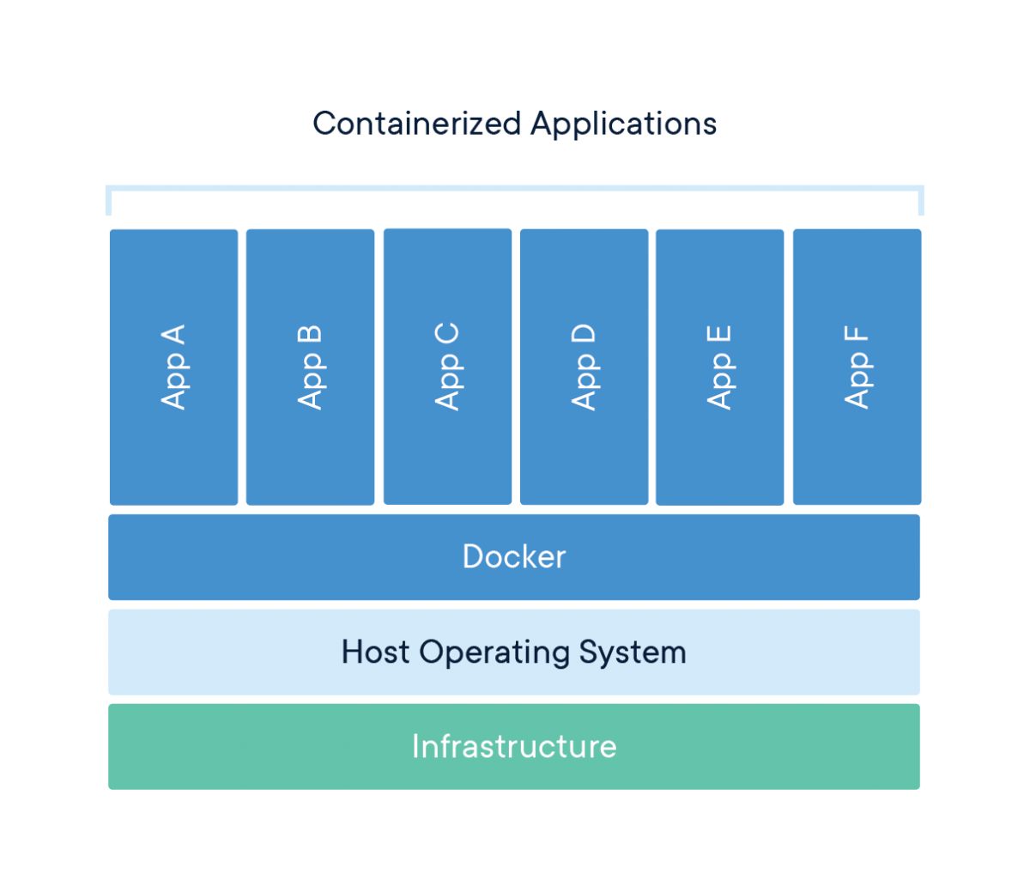
What is Docker?
Package Software into Standardized Units for Development, Shipment and Deployment
A container is a standard unit of software that packages up code and all its dependencies so the application runs quickly and reliably from one computing environment to another.
Example “My Java app + JRE” is contained within a container image

Slide 4
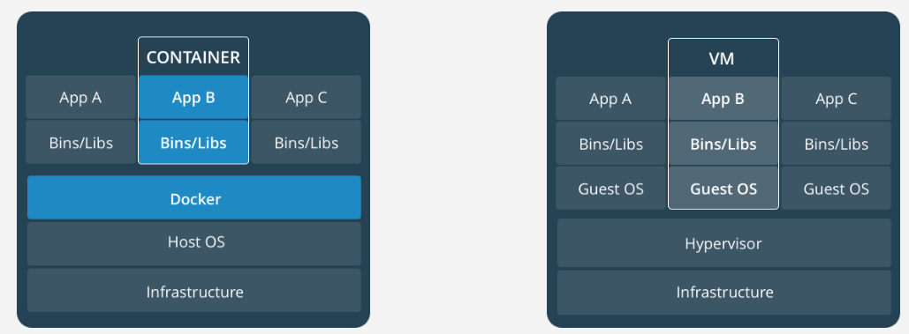
Docker vs Virtualization
Unlike VMs, container don’t contain the operating system, this make them more lightweight. And therefore easier to distribute

Slide 5
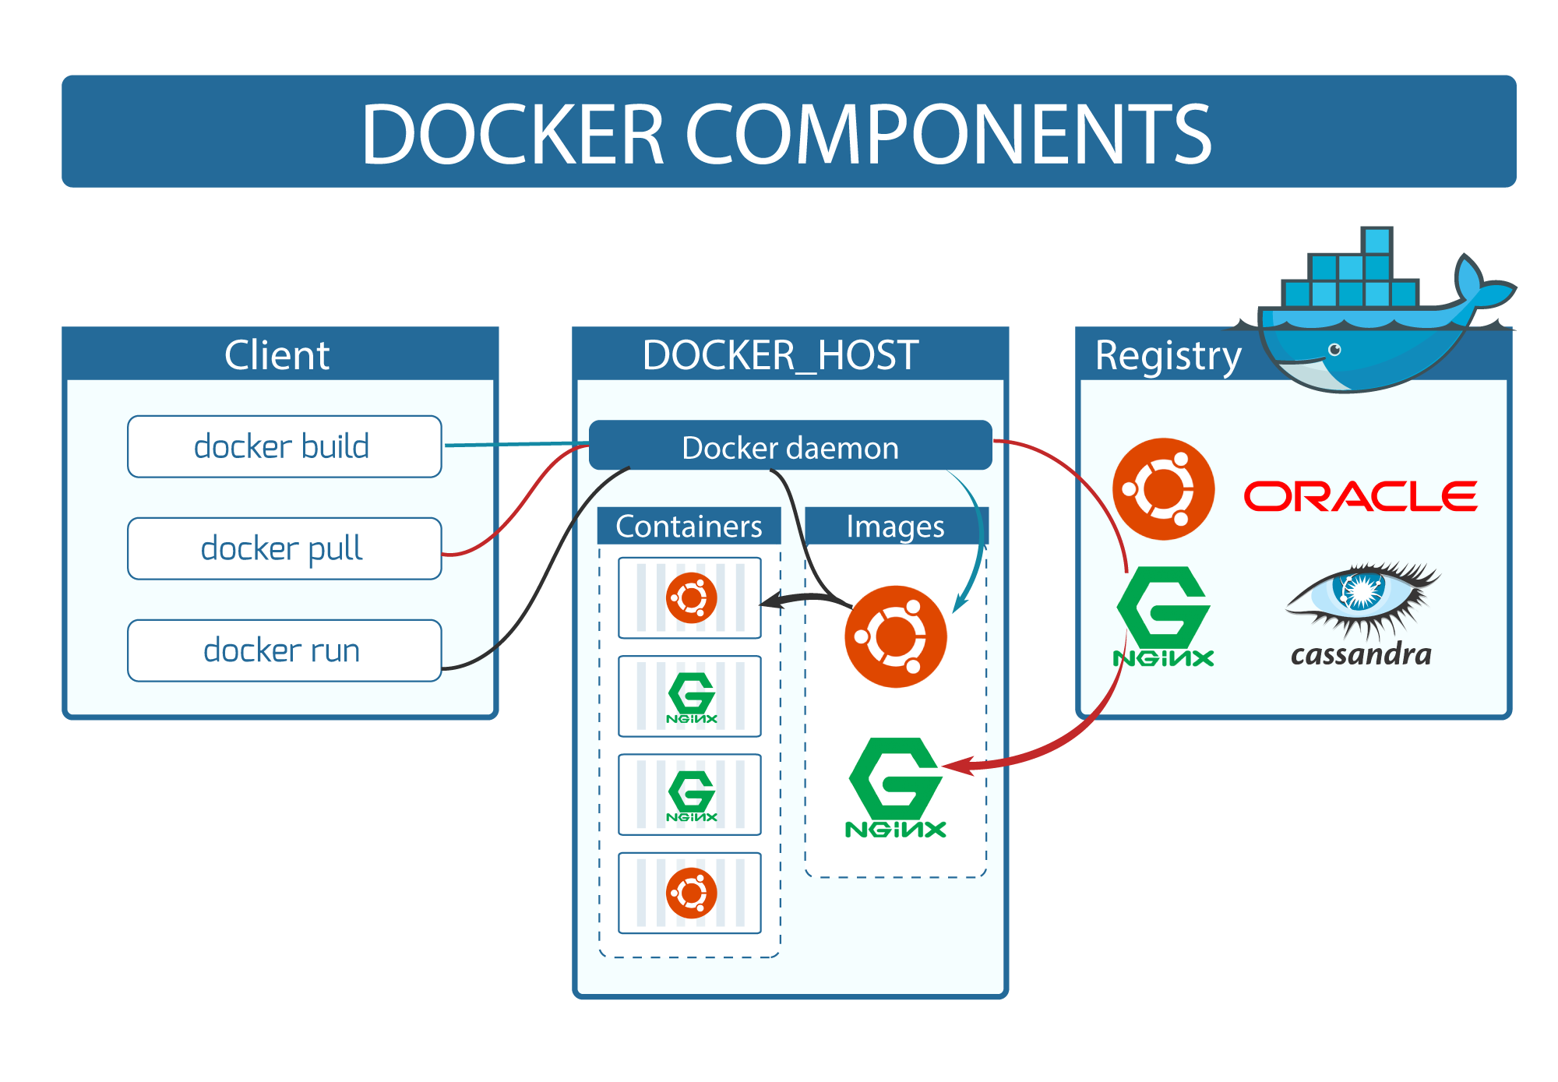

Slide 6
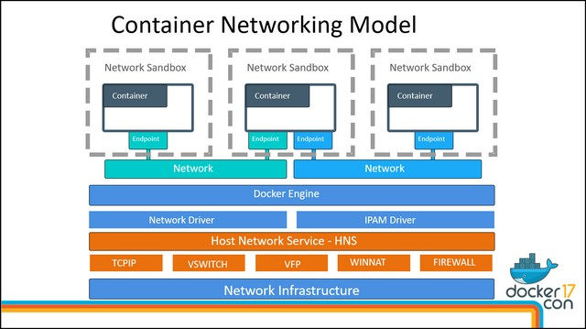
Docker Networking and Container Isolation

Slide 7
Hello World Docker Style
docker run hello-world

Slide 8
Prac – Start a Container
docker run node
docker run node npm --version

Slide 9
Mount a volume
docker run --volume=C:\source:/app node ls /app –al
docker run --volume=C:\source:/app –w=/app node ls –al

Slide 10
Build a project form a mount volume
Git clone https://github.com/mobxjs/mobx-react-todomvc.git
docker run --volume=C:\source\mobx-react-todomvc:/app –w=/app node npm install
docker run --volume=C:\source\mobx-react-todomvc:/app –w=/app node npm start
Open localhost:3000 – Fail!

Slide 11
Check running containers
docker ps
docker stop <id>

Slide 12

Exposing Ports from the Sandbox
Docker run –p 3000:3000 --volume=C:\source\mobx-react-todomvc:/app –w=/app node npm start
Open http://localhost:3000/#/

Slide 13
How about a database to store my TODO?
Multiple Docker containers in a set?
…

Slide 14

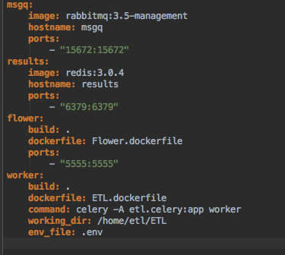
Docker Compose
YAML based templating system for container creation and orchestration
What we just did on the command line we declare in yaml instead

Slide 15
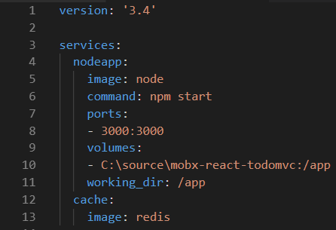
Create a Docker Compose that includes a Cache Server
The same options we had with “docker run” but in YAML

Slide 16
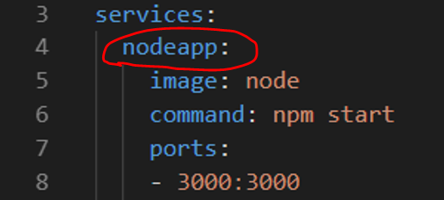
Internal DNS
Docker allows the containers within a compose to resolve each other using their keyed name form the compose
For example “ping nodeapp” from the redis server where nodeapp is the key in the compose, will resolve this containers IP internally within the sandbox

Slide 17
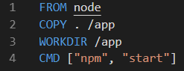
Dockerfile
Docker files create a distributable docker image
Chunking system for easy distribution

Slide 18
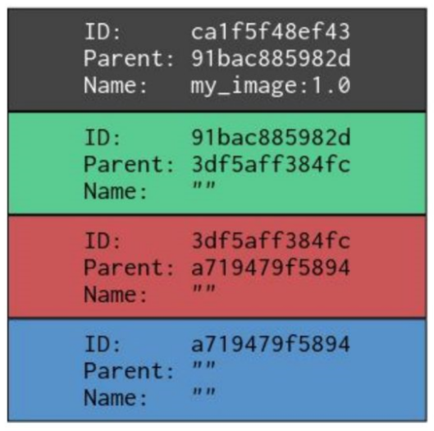
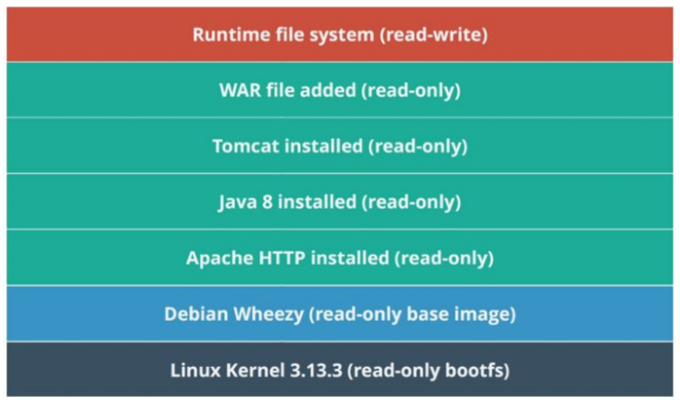
Docker Image Layers

Slide 19
Create docker file
docker build . –t mytodoapp
docker run mytodoapp
docker history mytodoapp

Slide 20
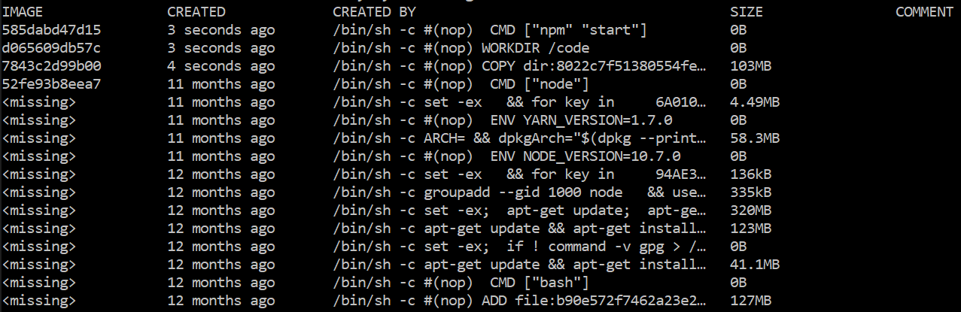
View history of docker image chucks
The first 4 are from our docker file, the rest are the history from the image “node” and how it was built

Slide 21
Publishing your image to share with others
docker push ?
Not today …

Slide 22
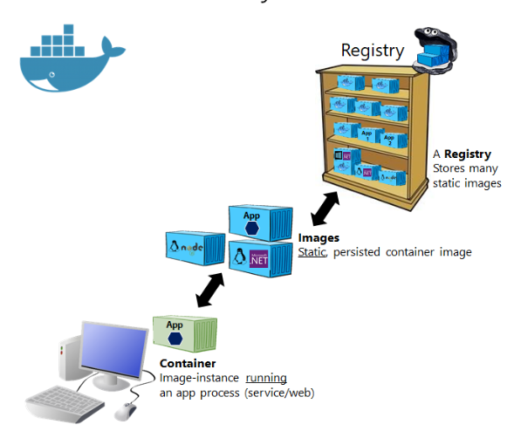
What is a Docker Registry?
Stores and distributes images
A running image is known as a “container”
Uses hash chunking system for storage and distribution

Slide 23
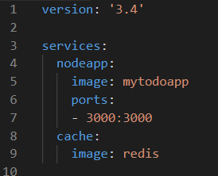
Change docker compose - Use the Docker file
Remove params defined in Dockerfile

Slide 24
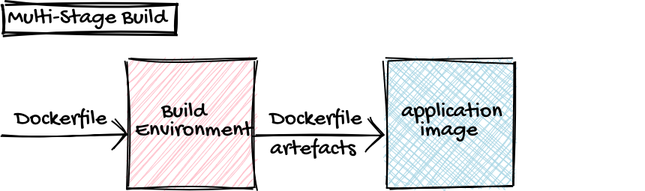
What about NPM Install?
Docker Compose can also be used to automate builds
Known as Multi-Staged Dockerfile
JDK
NET SDK
etc
JRE
NET Runtime
etc

Slide 25
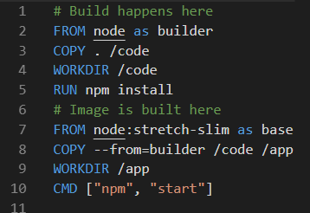
Create a Multi stage Dockerfile
Builder image has full SDK
Base image uses lighter image (doesn’t include SDK) for distribution
Final image is based on the last FROM statement
Docker build . –t mytodoapp

Slide 26
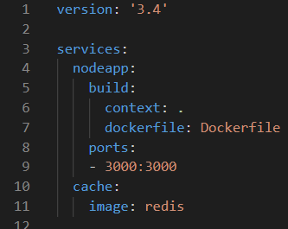
Add Build declaration to docker-compose
docker-compose up –build
Compose up command now triggers a build of your software
Multiple projects can be included in a single compose
Example – nodejs react front end, plus Java backend, plus SQL database, etc

Slide 27
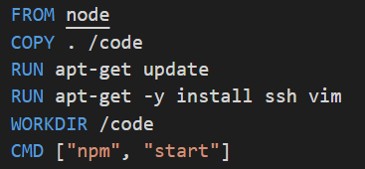
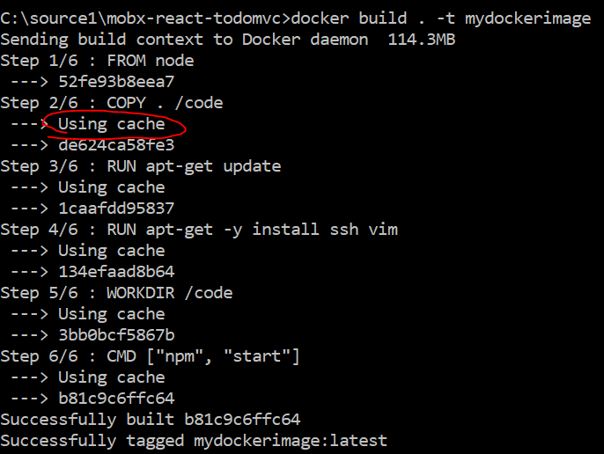
Performance of Dockerfiles – Incremental Build Time
RUN TWICE: docker build . -t mydockerimage
Add white space to js file
RUN AGAIN

Slide 28
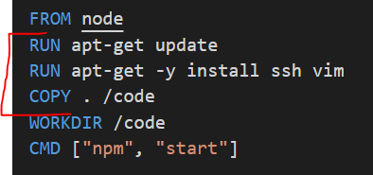
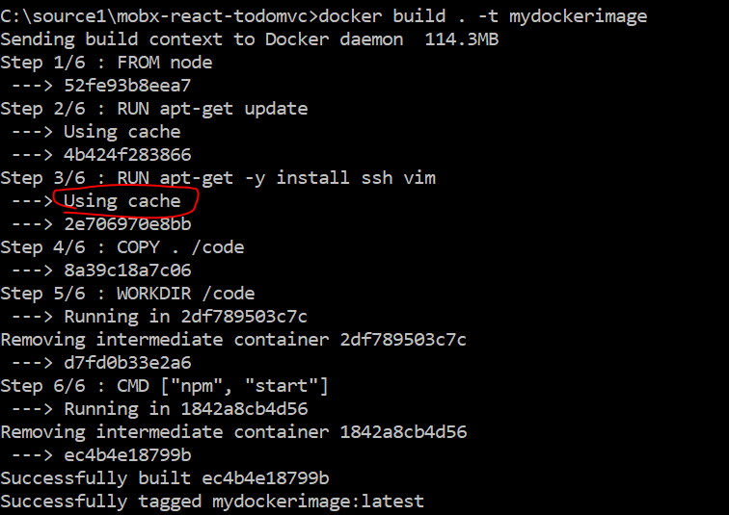
Performance of Dockerfiles – Incremental Build Time
Swap order
Run once: docker build . -t mydockerimage
Change js file
Run again: docker build . -t mydockerimage
The apt-get install is now cached and wont rerun when you change the javascript files

Slide 29
Performance of Dockerfiles – Image size
Remove unnecessary dependencies
e.g. vim and ssh should NOT be on production container images
Remove Package manager cache
RUN rm –rf /var/lib/apt/lists/*

Slide 30
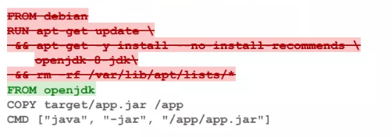
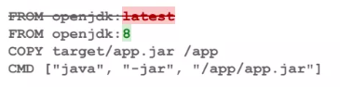
Maintainability
Use official images where possible, they will have installation steps done and best practices applied
Do not use the latest tag. Because based on the time you build your image behavior will change

Slide 31
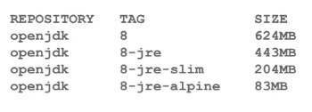
Maintainability
Look for Minimal Image flavors
Examples: Alpine, stretch, slim

Slide 32
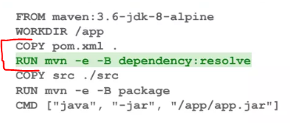
Building in Docker (Multi stage)
Fetch Dependencies in a separate step (separate RUN and COPY)
e.g. npm install, etc
This will separate cache the dependency download work

Slide 33
Q and A
Contact details
#WeAreAlwaysHiring

